Slide 1

Blood Bank Management System
A Web Application Project using Django
Presenter
Bhanu Partap Singh Manhas
2020A1R070
CSE
DEPARTMENT OF COMPUTER SCIENCE AND ENGINEERING
MIET(Autonomous), JAMMU

Slide 2
Table of Contents
Problem Statement
Solutions
Scope of the project
Tech Stack
Features
Workflow
Demonstration
References

Slide 3
Problem Statement
The following problem arises when using a typical blood bank’s existing system:
• Personal profile accessibility
The donor’s information can only be updated by the administrators of the blood bank. A donor can update their information by calling, faxing, e-mailing, but not by themselves. This is a waste of time just for updating a piece of information and it may be troublesome for some donors.
• Donation record accessibility
The donor ID card is the only tangible evidence that contains the donor’s recent donation records, if the card gets lost, donors may find it difficult to schedule their next appointment since they are not able to see the last time they had donated blood.

Slide 4
Problem Statement
• Searching for Required Blood Group
Searching for the particular blood groups in the specific regions with the donors’s information.

Slide 5
Solution
This Blood Bank Management System in Django has functionalities of enlisting blood givers and through which individuals requiring blood can look and contact them after donors are registered. The blood request and recipient blood need to be approved or rejected by the system. The blood stock and blood donations are not limited to the users.
This websites gives highlights of admin board through which admin can contact all
givers list, all blood banks needed during donations through admin.
- Additionally, this system has a contact page where all contact details are accessible if a
blood emergency happens and the website is inaccessible.

Slide 6
Scope of the Project
The system functions and features of our system will include the following:
Registration
This function allows the donor and administrator to register as a user to interact with the system. The system requires the user to login before viewing and editing any information.
View and edit information online
Donors are allowed to view their blood donation records online by their given account. They can also edit their personal information through the system.

Slide 7
Scope of the Project
Manage blood inventory
The blood stock that is checked-in to the system first will be the first one given to the hospital when requested. When the blood stock is expired, the administrator is responsible for removing the stock from the inventory and updating the system.
Notify by E-mail
Hospitals can receive e-mail responding to their requested blood whether it is available in our stock or not.
Summary report
The system will be able to generate a report to summarize all records including blood donation, blood requests and blood stock for the administrator.

Slide 8
Tech Stack
Python
Django
SQLITE Database.
HTML and CSS
JavaScript
Bootstrap

Slide 9
Features
Homepage
Admin Panel
Donar’s Panel/Donate blood
Blood Request
Donor Registration
Blood Request Management

Slide 10
WORKFLOW
13/09/2022
Blood Bank Management
10
10

Slide 11
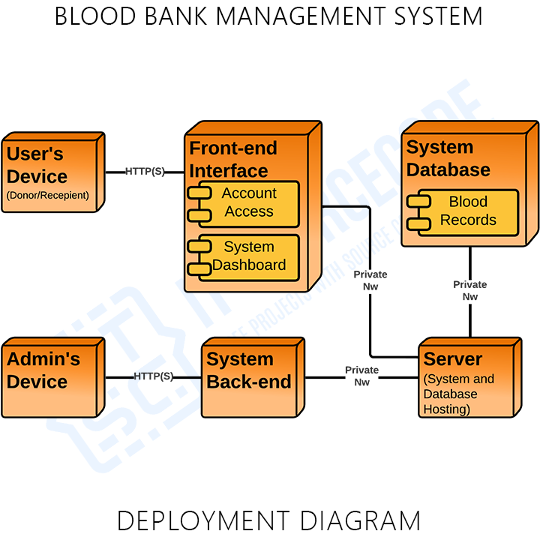

Slide 12
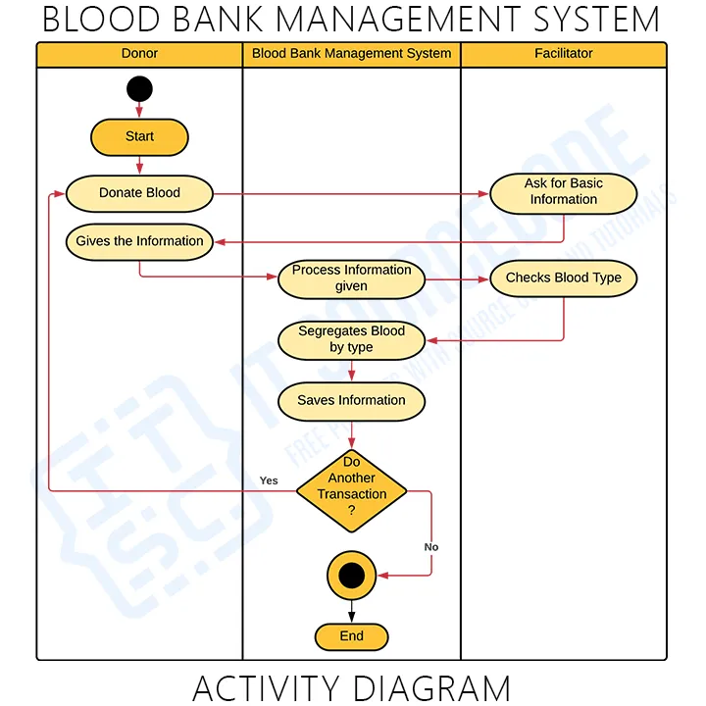

Slide 13
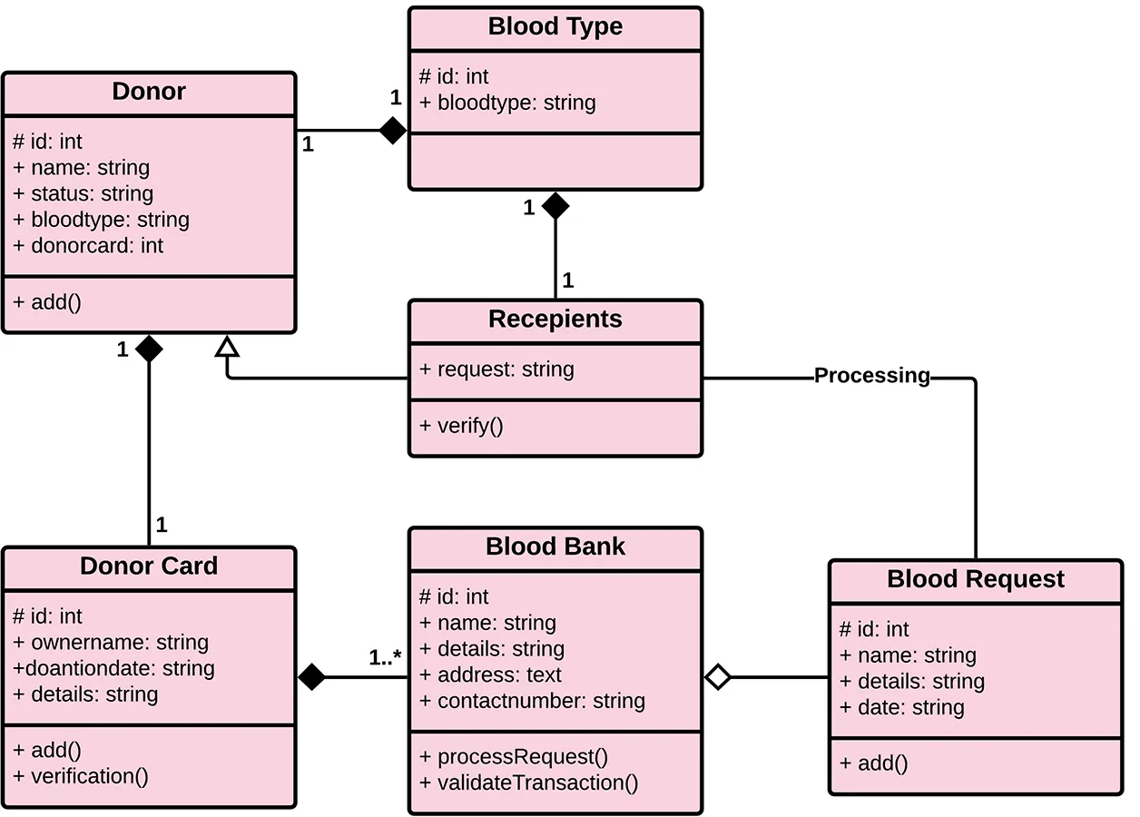

Slide 14
Demonstration

Slide 15
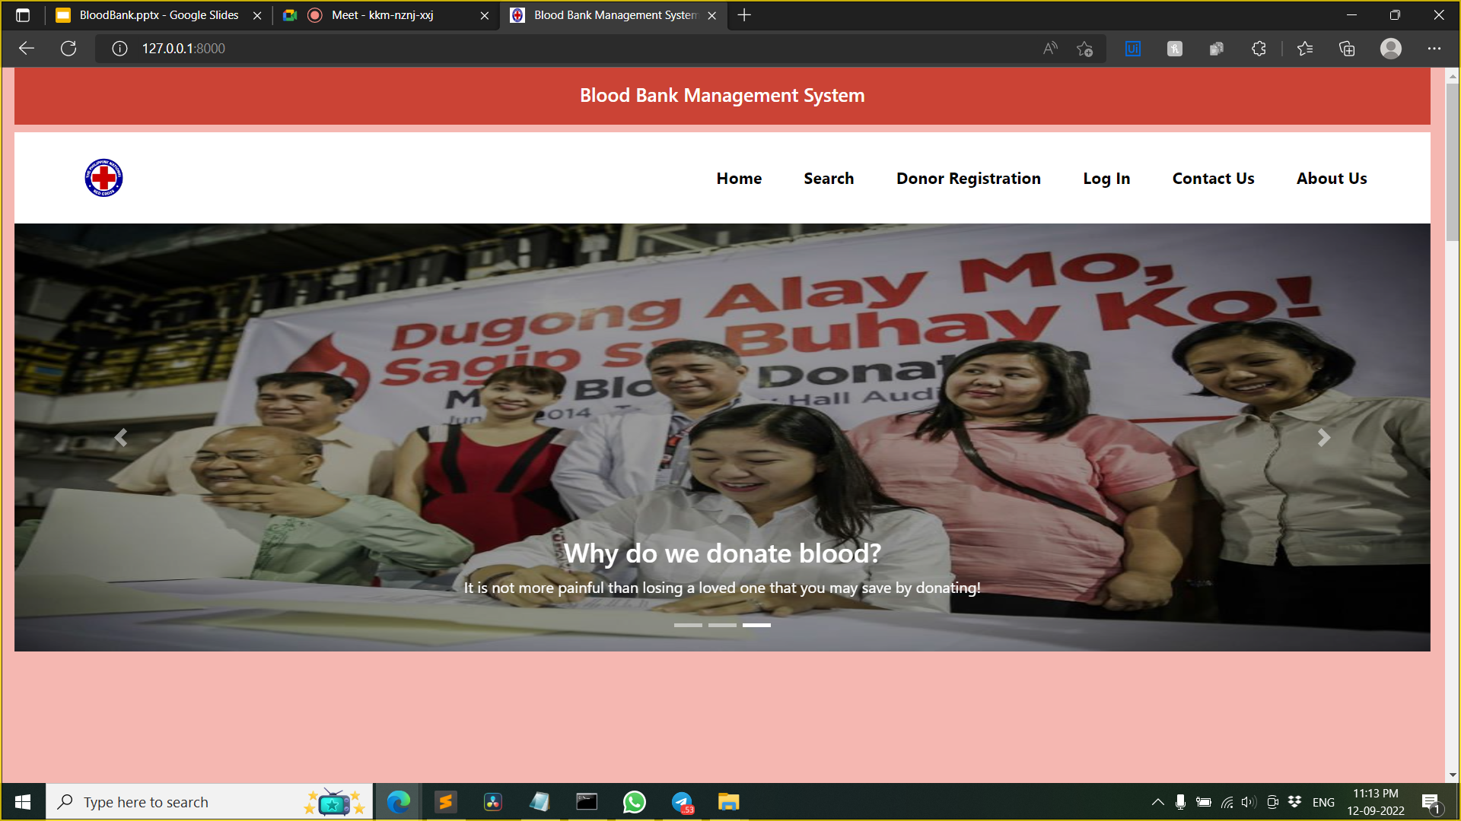
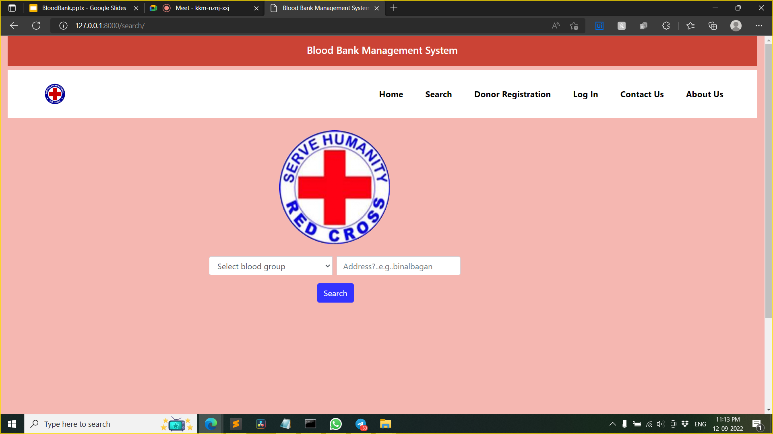
INTERFACE DESIGN
-Home page of the website
-Requester’s page (searching for blood)

Slide 16
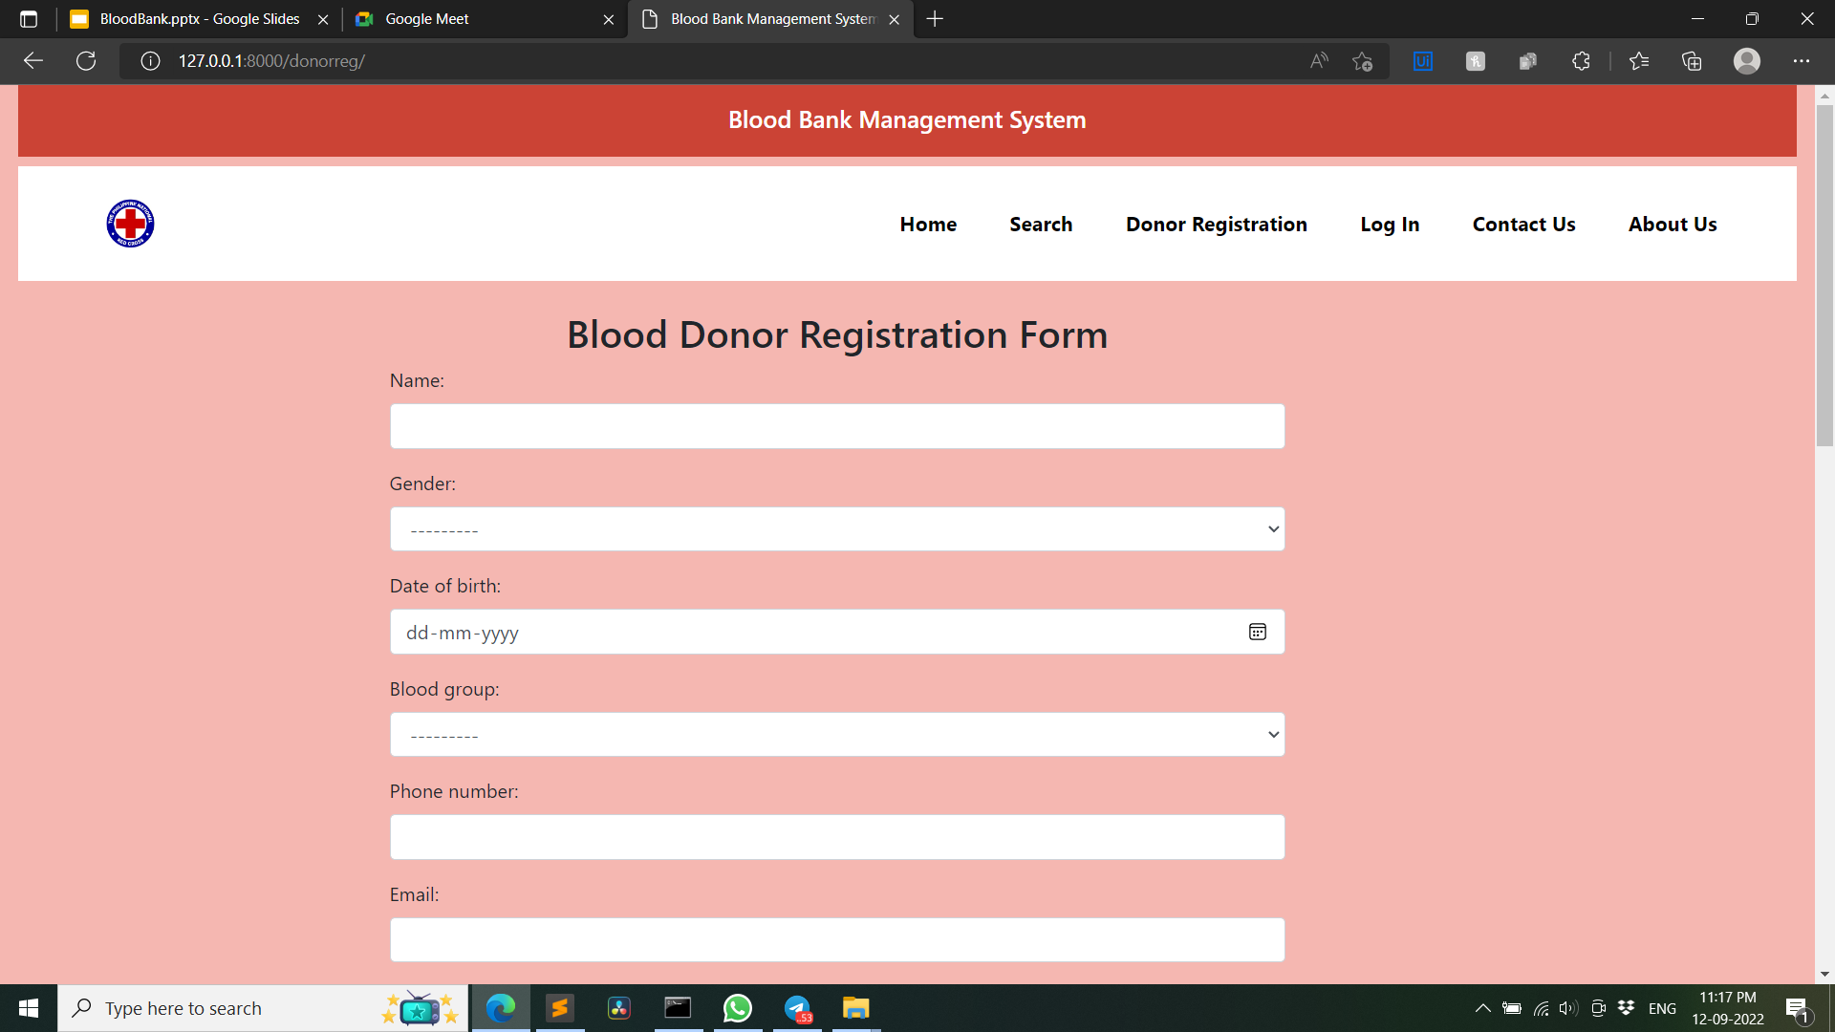
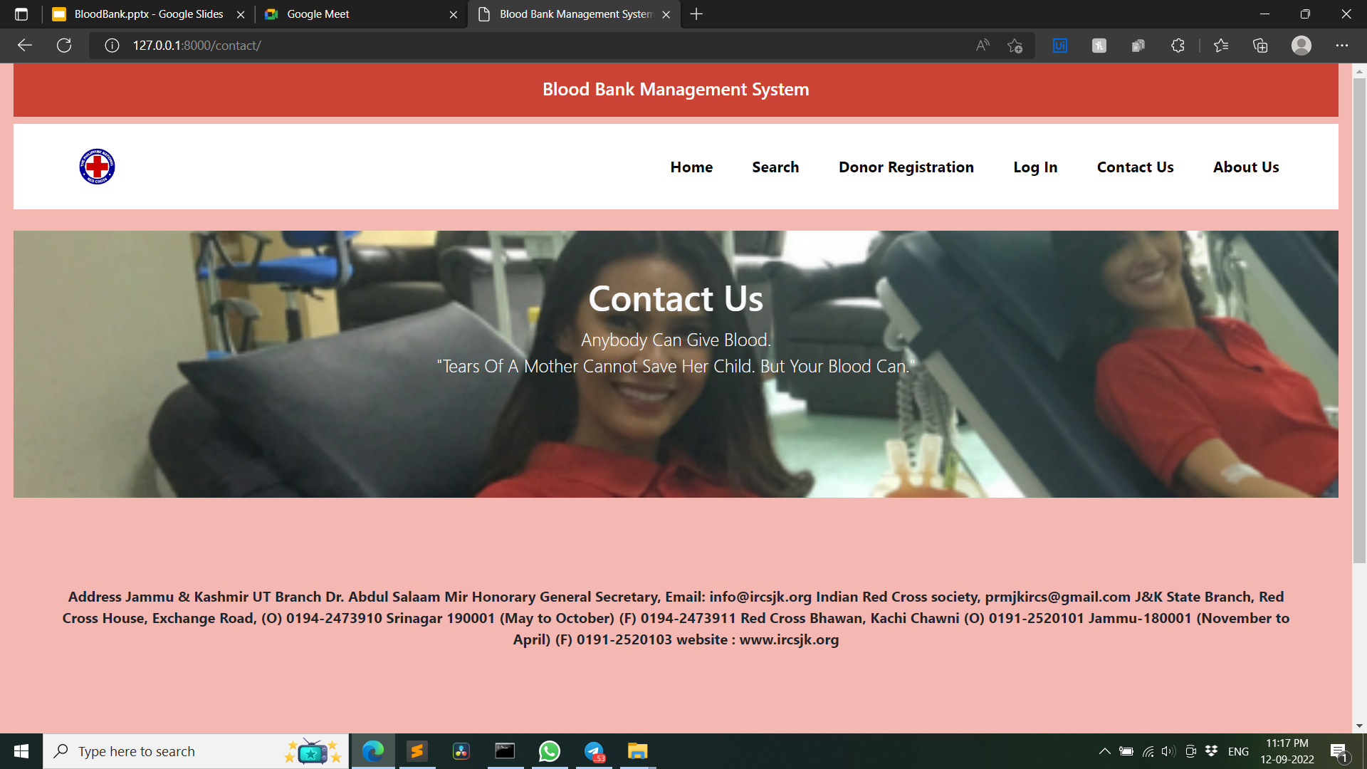
INTERFACE DESIGN
-Donar’s Registration Page
-Page for contacting the IRCS

Slide 17

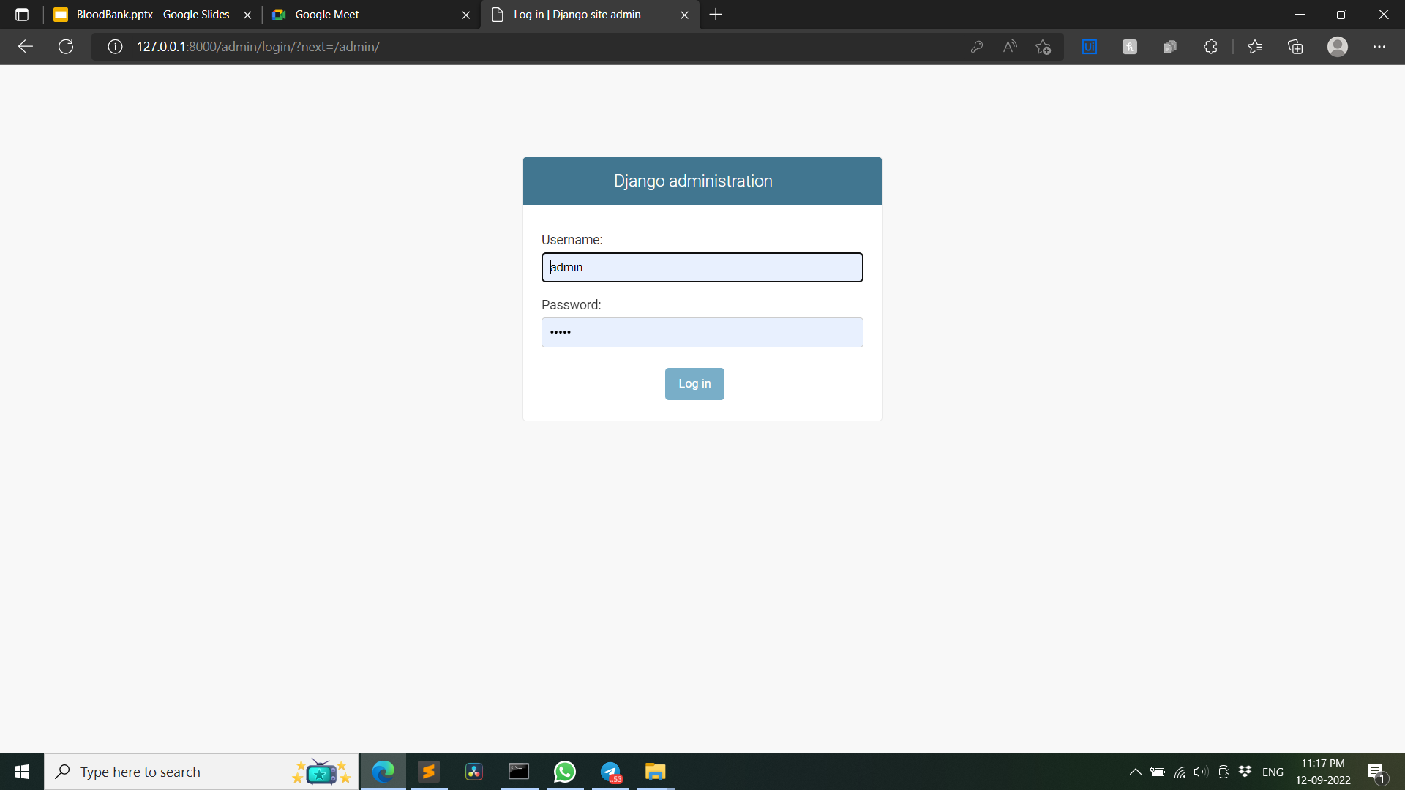
INTERFACE DESIGN
-About the Indian Red Cross Society
-Admin Login

Slide 18
References
IRCS Home | Indian Red Cross Society
https://www.indianredcross.org/ircs/index.php
https://indianredcross.org/ircs/aboutus
https://www.geeksforgeeks.org/
www.youtube.com
https://indianredcross.org/ircs/northzone
https://www.bing.com/images/search?q=blood+bank+management+system&form=HDRSC2&first=1&tsc=ImageHoverTitle

Slide 19


